Slide 1
Al-Farabi Kazakh National University
Higher School of Medicine
Carboxylic acids and their derivatives

Slide 2
INSTRUCTORS
Gulnaz Seitimova, PhD, Chemistry
Bates Kudaibergenova, PhD, Chemistry
Dias Tastanbekov, MSc, Chemistry

Slide 3
LEARNING OUTCOMES
As a result of the lesson you will be able to:
- Carboxylic acids and their derivatives: properties and names
- Acidity of carboxylic acids
- Reactions of carboxylic acids: ester and amide formation
- Hydrolysis of esters and amides
- Polyamides and polyesters
- Phosphoric acid derivatives
- name simple carboxylic acids, esters, and amides given a structure and write a struc-
ture given a name
- describe the acidity of different carboxylic acids and predict the products obtained when they react with strong bases
- describe how esters and amides are formed from carboxylic acids

Slide 4
Literature
Organic Chemistry. International student version. 10ed. T.w.Graham Solomons, Craig. B. Fryhle., pp. 779 - 869

Slide 5
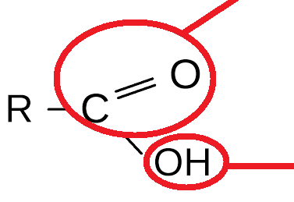
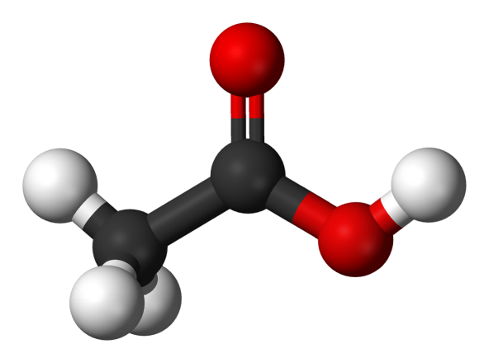
Structure Of Carboxylic Acids
carbonyl
hydroxyl
Notes:
Carboxylic acids are organic acids contain one or more carboxyl group, which is a combination of carbonyl group C=O and hydroxyl group O-H
It is often written in condensed form as –CO2H or –COOH
Carboxylic acids are classified as aliphatic R-COOH or aromatic Ar-COOH depending on the group bonded to the carboxylic group.
The fatty acid is long chain aliphatic acids CH3-(CH2)16-COOH

Slide 6

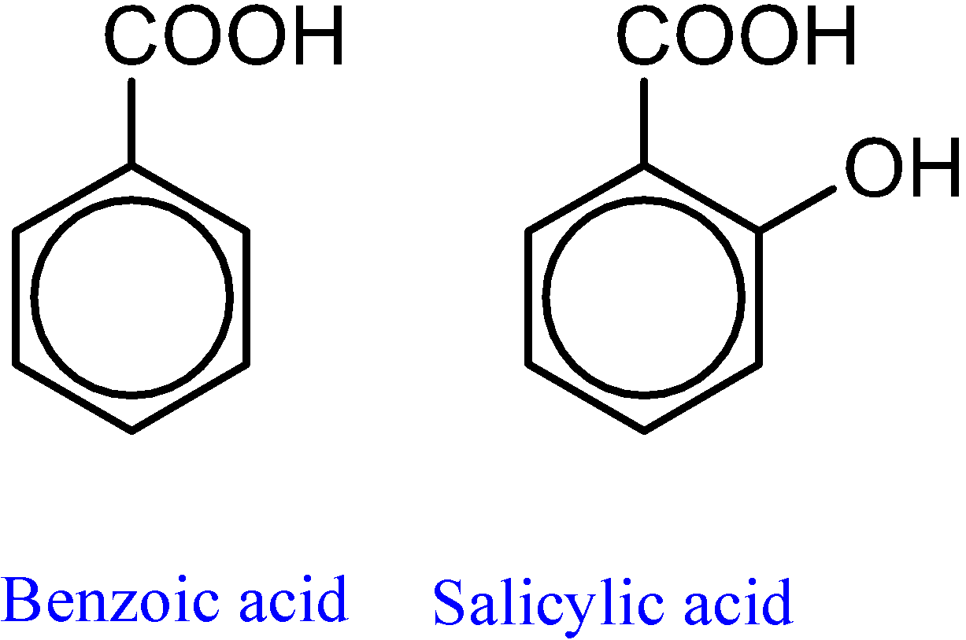
Example of dicarboxylic acids
Succinic acid
Some aromatic acids have common names
Notes:
succinic acid is a bactericidal compound, and salicylic acid is an aspirin, an antipyretic
янтарная кислота - бактерицидное соединение, а салициловая кислота - аспирин, жаропонижающее

Slide 7
Nomenclature Of Carboxylic Acids
Some carboxylic acids are called after characteristic properties or their origin.
All common names ending -ic acid
Formula Common name origin of name
HCOOH formic acid Latin for ant
CH₃COOH acetic acid Latin for vinegar
CH₃CH₂COOH propionic acid Greek for milk
CH₃ (CH₂)₂COOH butyric acid Latin for butter
CH₃ (CH₂)₃COOH valeric acid Valerian root
The positions of the carbons present on the acid chain, are located by the Greek letters α indicating the carbon atom next to COOH group (C2), β (C3), etc.
5 4 3 2 1
-C—C—C—C—COOH
δ γ β α
7
Notes:
it is only important to explain the alpha, beta, and gamma carbons of the COOH groupit is only important to explain the alpha, beta, and gamma carbons of the OT-Coon group
важно только обьяснить альфа, бета, гамма углероды от -СООН группы

Slide 8

IUPAC Nomenclature of carboxylic acids
The longest continuous C-chain with -COOH + –oic acid.
2) Carbon with COOH is #1
3) substituents prefixes in alphabetical order.
Examples: (CH₃)₂CH - CH(CH₃) - CH₂ - CH₂ - COOH
is called 4,5-Dimethylhexanoic acid
Notes:
The longest continuous C-chain contains the COOH group to get the root name of the parent hydrocarbon, then replace the ending -e by the suffix –oic acid.
Number the chain starting with the carbon of COOH group as C-1
If there are substituents identify their names, positions and list them as prefixes in alphabetical order.
Examples: (CH3)2CH - CH(CH3) - CH2 - CH2 - COOH
is called 4,5-Dimethylhexanoic acid

Slide 9
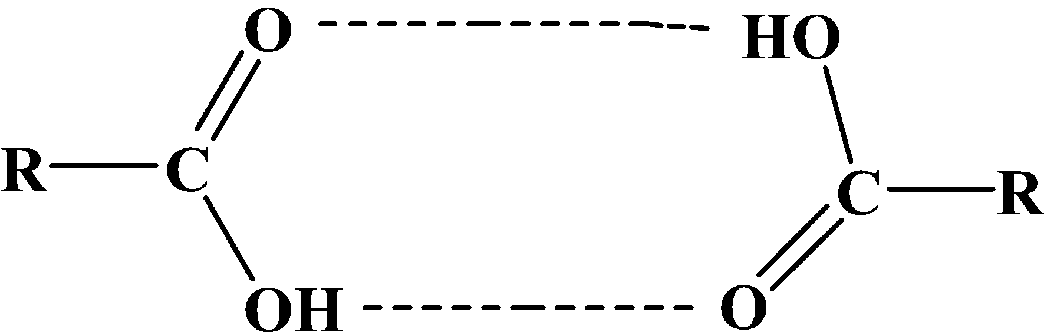
Physical Properties of Carboxylic Acids
1) Boiling Points
Carboxylic acids have exceptionally high boiling points than alcohols of identical relative molecular masses, For example:
M.F. M.W bp / °C
Propanol C₃H₈O 60.01 97.2
Ethanoic acid C₂H₄O₂ 60.05 118
Carboxylic acids have higher boiling points than alcohols and aldehydes, because their dimeric structures.
Hydrogen-bonded acid dimer
9
Notes:
compare and contrast the structures, reactions, hydrogen bonding, water solubility, boiling points, and acidity or basicity of carboxylic acids, esters, and amides - следующие несколько слайдов будут охватывать этот outcome

Slide 10
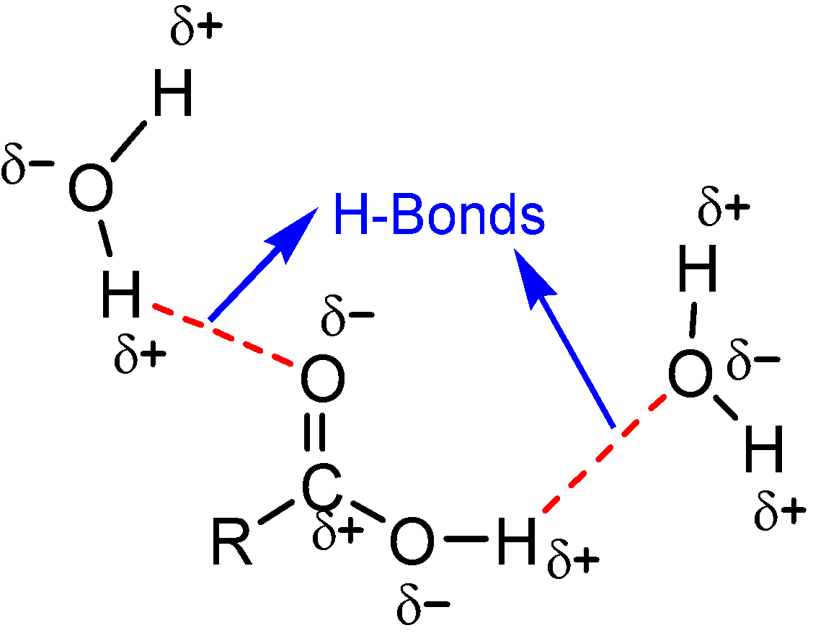
2) Solubility
Carboxylic acids are polar, they can form hydrogen bonds with water molecules
The first four aliphatic acids are completely miscible in water. Higher members are less soluble
Aromatic acids are insoluble in water
Notes:
физические свойства карбоксильных кислот, кстати те же самые для их производных

Slide 11
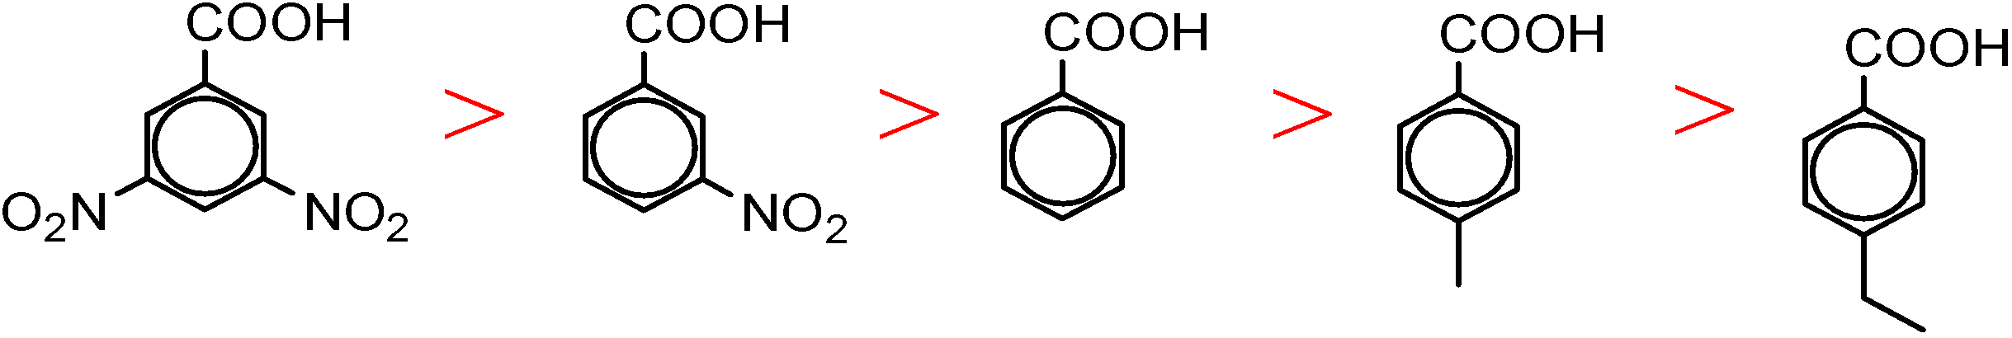
Acidity of carboxylic acids
Carboxylic acids are stronger acids compared to alcohols and phenols
.
HCOOH > CH₃COOH > CH₃CH₂COOH > CH₃CH₂CH₂CH₂COOH ( size of R group)
Cl₃CCOOH > Cl₂CHCOOH > ClCH₂COOH > CH₃COOH ( number of e.w.g.)
Notes:
сделать упор на увеличении R = уменьшается кислотность и на увеличении галогенов на альфа-углероде

Slide 12
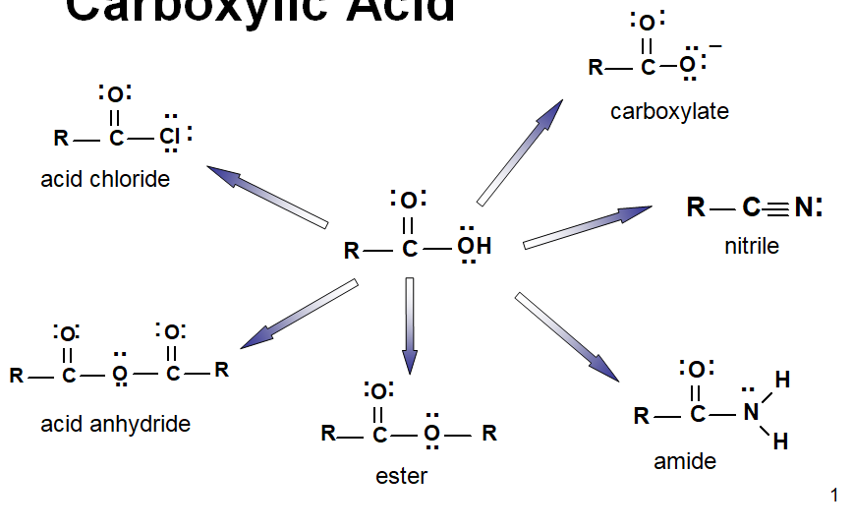
Derivatives of carboxylic acids and their names

Slide 13
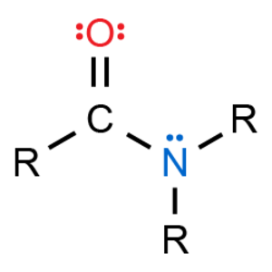
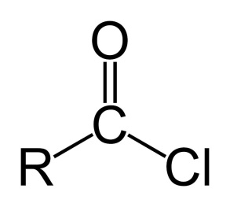
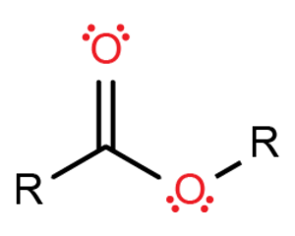
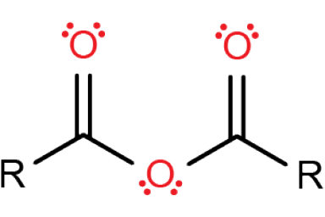
Carboxylic Acid Derivatives
Acid Chloride Ester Amide Acid anhydride
The derivatives of carboxylic acids are compounds in which the -OH of carboxylic acid is replaced by nucleopile (-X for acid halide, -OR for ester, -NH₂, -NHR, -NR₂ for amids, -OOCR for anhydride).
Carboxylic acids derivatives can converted to carboxylic acids by simple acidic or basic hydrolysis.
Notes:
физические Свойства разнообразны и различны между собой

Slide 14
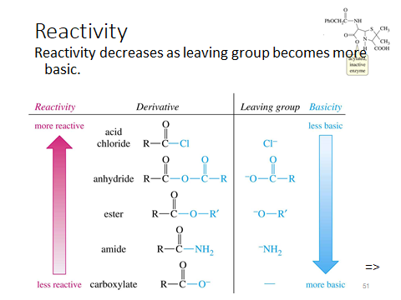

Slide 15
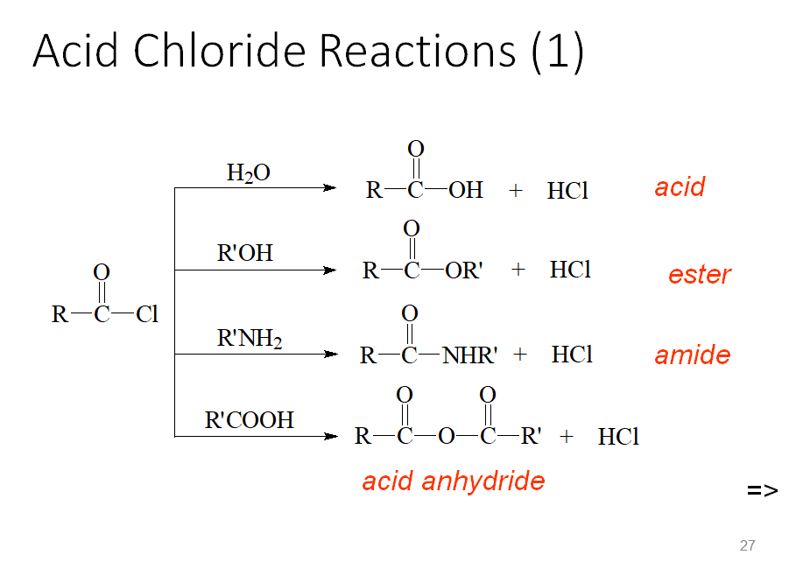

Slide 16
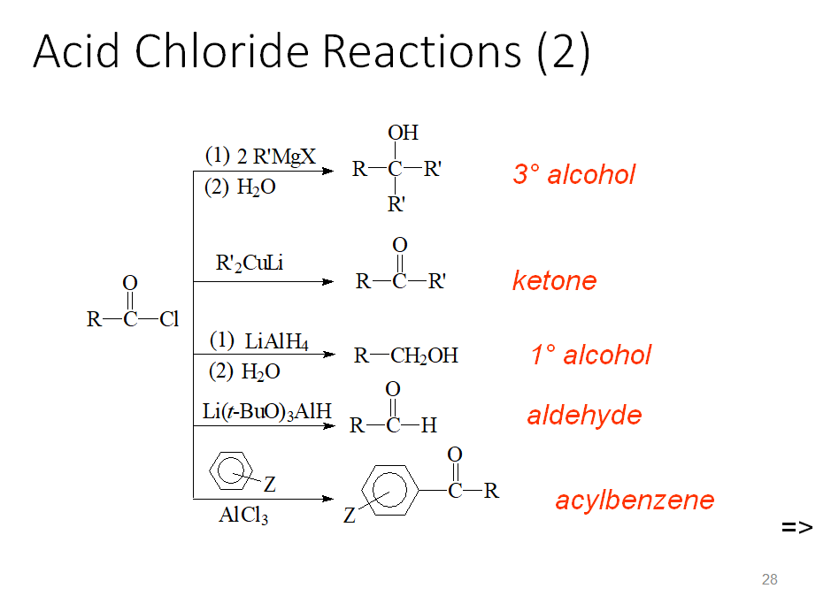

Slide 17
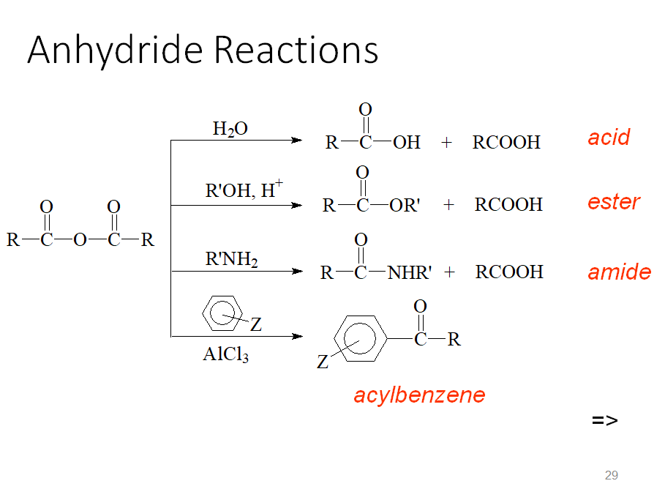

Slide 18
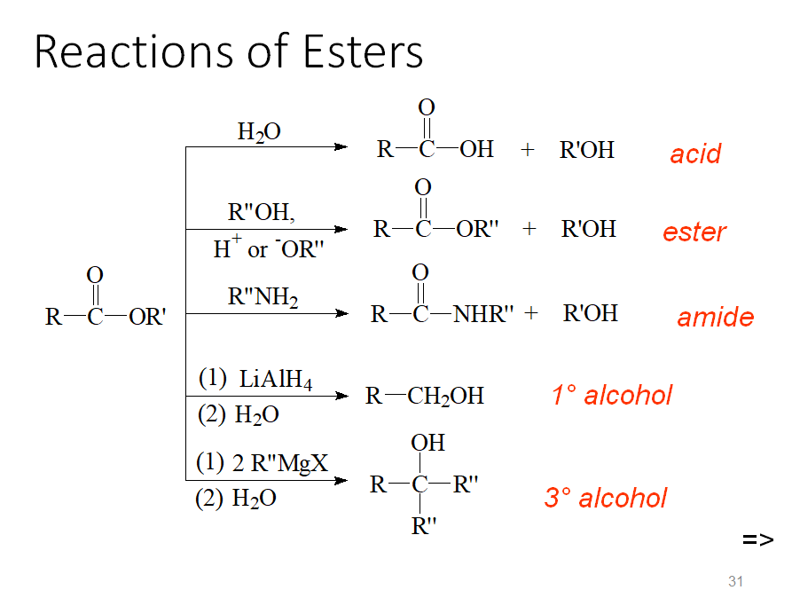

Slide 19
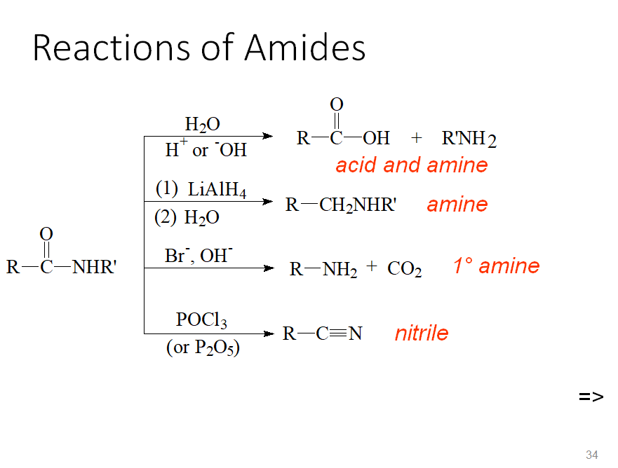

Slide 20
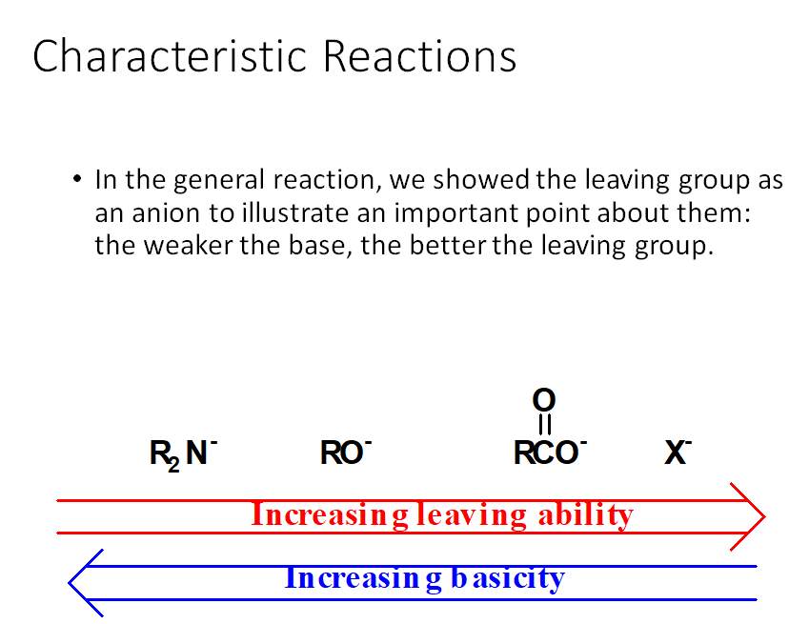

Slide 21
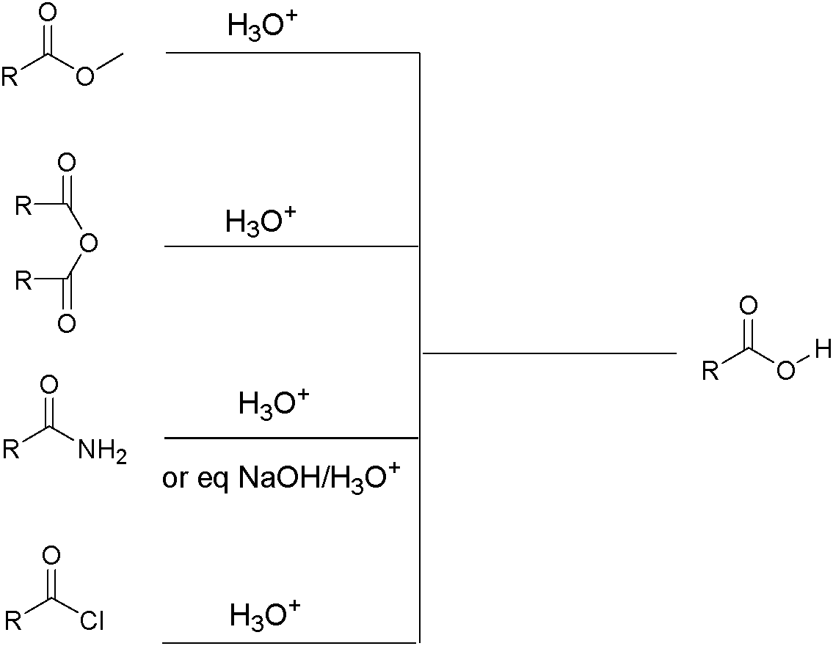
Reaction of Derivatives of carboxylic acid
On hydrolysis (reaction with H₂O) all carboxylic acid derivatives convert to carboxylic acid.
Ester
Acid anhydride
Amid
Acid halide
Carboxylic acid

Slide 22
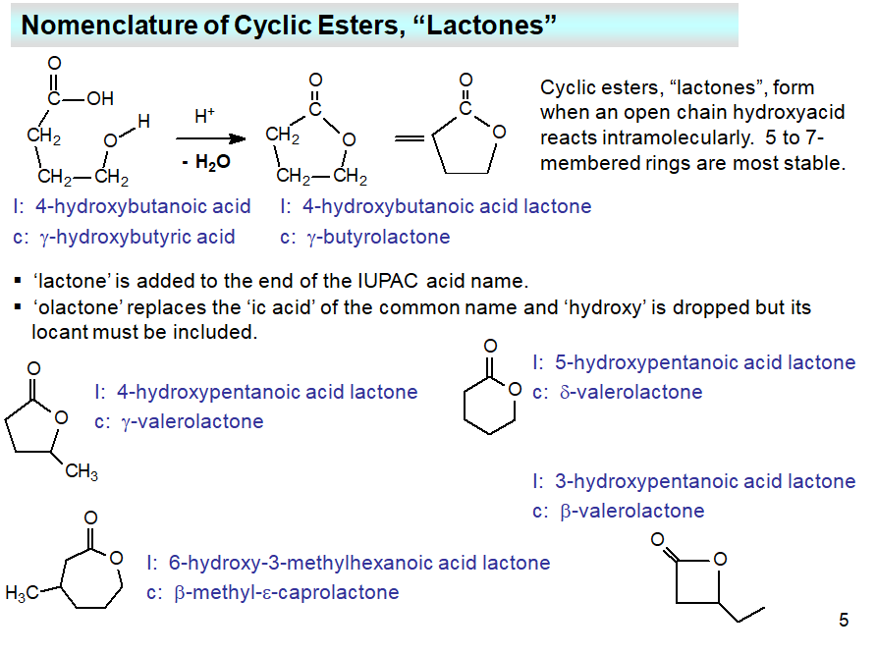
Notes:
a special case of carboxylic acid derivatives is lactones.
частный случай производных карбоксильных кислот - лактоны.

Slide 23
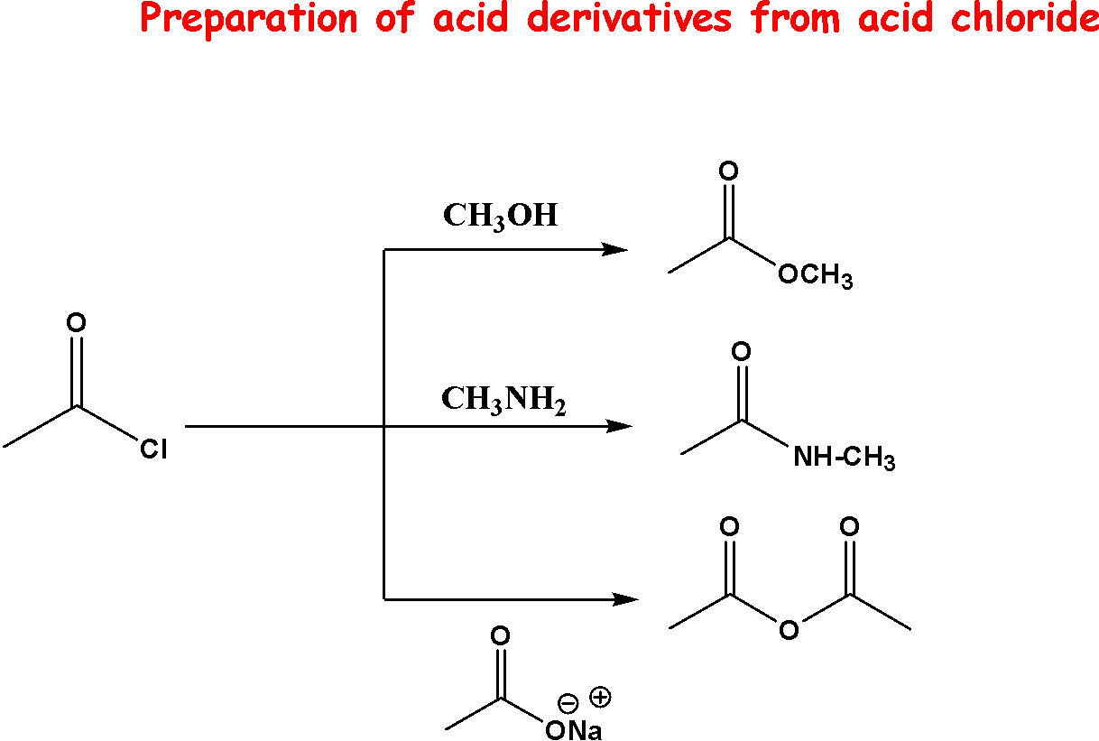
23

Slide 24
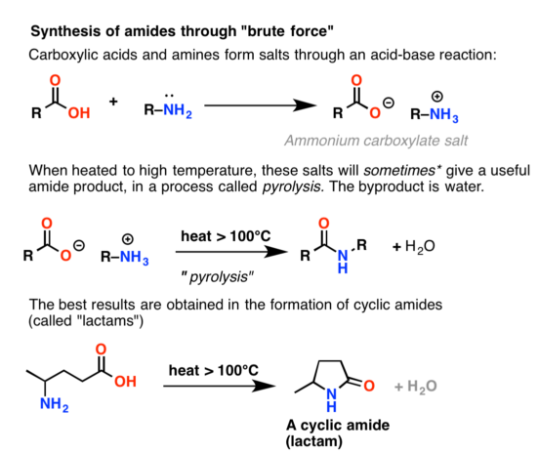
Conversion of Carboxylic Acids to Amides
Notes:
Reactions of carboxylic acids: ester and amide formation

Slide 25
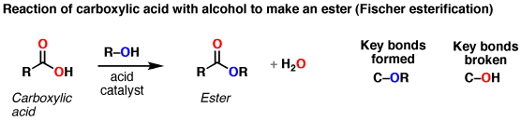
Conversion of Carboxylic Acids to Esters
When a carboxylic acid is treated with an alcohol and an acid catalyst, an ester is formed (along with water). ... The alcohol is generally used as solvent so is present in large excess.
Notes:
Reactions of carboxylic acids: ester and amide formation

Slide 26
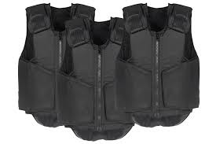
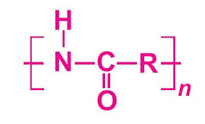

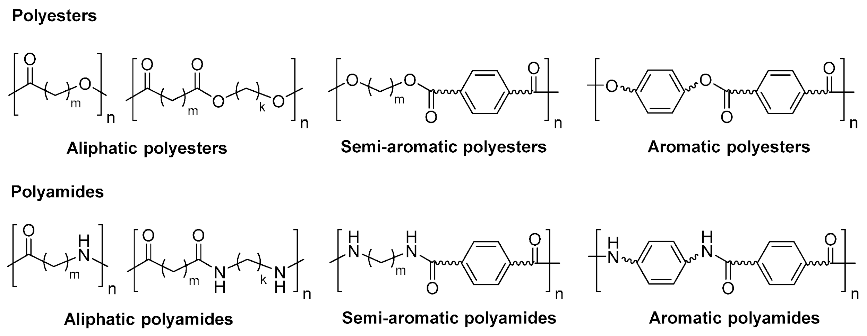
- Polyamides
Polyamides occur both naturally and artificially. Examples of naturally occurring polyamides are proteins, such as wool and silk
Artificially polyamides can be materials such as nylons, aramids (kevlar fiber, thermo heat fiber), and poly(aspartate)

Slide 27
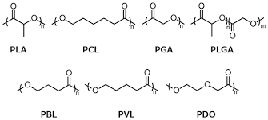
common Polyesters
Natural polyesters and a few synthetic ones are biodegradable, but most synthetic polyesters are not
The material is used extensively in clothing.

Slide 28

- Phosphoric acid derivatives
Phosphoric acid, pyrophosphoric acid, and triphosphoric acid occur in living cells as esters. Just as alcohols react with carboxylic acids, they also react with phosphoric acid, pyrophosphoric and note that these esters are also acids.
The esters are also acid anhydrides of phosphoric acid. The oxygen atom between the phosphorus atoms is part of the anhydride bond. These compounds are analogs of acid anhydrides of carboxylic acids.

Slide 29
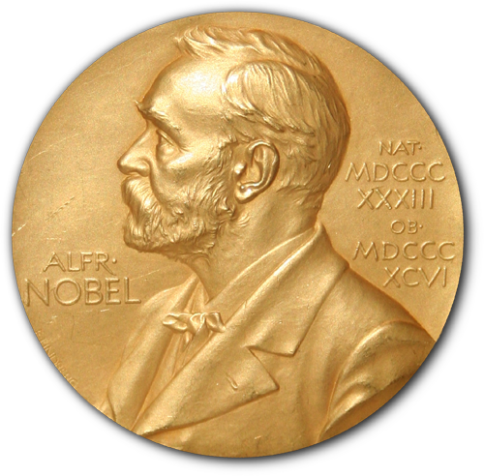
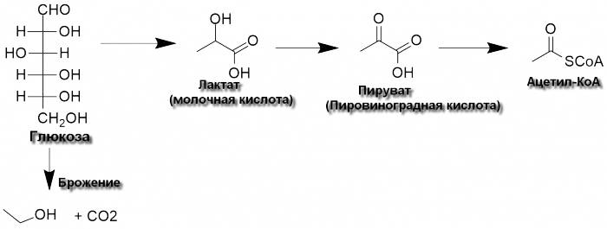
Case: Tricarboxylic acid cycle - Krebs cycle
For the discovery of the tricarboxylic acid cycle, proposed by Hans Krebs in 1937, 16 years later the Nobel Prize in Physiology and Medicine was awarded. The discovery is very significant. What is the meaning of this cycle and why is it so important?
The main source of energy for cells is glucose. It constantly contains special mechanisms that store or release glucose. Krebs cycle starts from glucose splitting to several carboxylic acids.
Lactic acid Pyruvic acid
Acetyl-coA
Notes:
Тема супер большая и невозможно рассматривать ее полностью. Поэтому будет рассмотрена частично.
из за молочной кислоты в мышцах после физических упражнений мы чувствуем боль

Slide 30
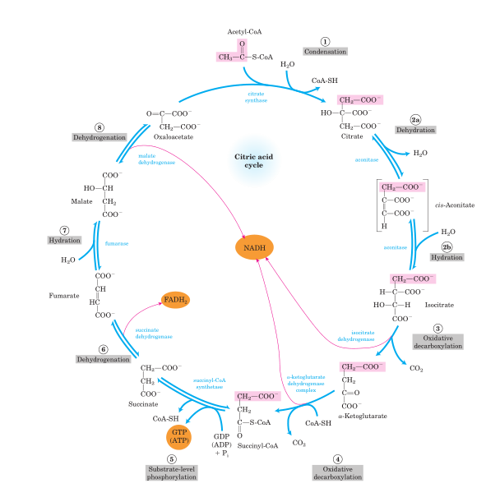
Krebs cycle
All reactions nitration of a product rises above the norm, it blocks the work of the enzyme responsible for its synthesis. And for reversible occur simultaneously in the cycle.
A stable concentration of each of the participants of the process is maintained. As soon as the conce reactions it is still easier: when the concentration of the product is exceeded, the reaction simply starts to go in the opposite direction.
Notes:
важно донести как Цикл кребса сам себя регулирует: либо блокируется фермент, ответственный за стадию, либо саморегулируется

Slide 31
a couple of small notes on the topic:
1. The cycle is called the tricarboxylic acid cycle, although not all of its products are tricarboxylic acids (there are only three of them: citric, cis-aconitic and isolimonic). The name stuck for historical reasons.
2. The energy losses in the cycle, despite the large number of stages, are rather small: this is provided by an appropriate ratio of the concentration of the starting materials and products.

Slide 32
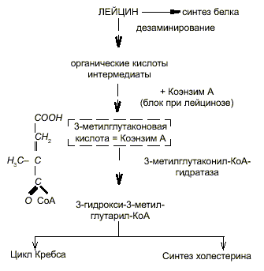
Синдром Барта, при которой маркером служит завышенная концентрация 3-метилглутаконовая кислота
Bart syndrome is a genetic disorder characterized by the association of congenital localized absence of skin, epidermolysis bullosa, lesions of the mouth mucosa, and dystrophic nails
Notes:
Bart's syndrome is a hereditary disease with X-linked recessive inheritance, but is also characteristic of mitochondrial insufficiency.
Maintenance therapy affects risk.
Mutations in mitochondria in every cell of the body.
Selective screening for hereditary diseases in Freiburg (Germany) revealed 242 cases of aciduria among 40,000 surveyed

